Slide 1
Module 4: Deep NEURAL NETWORKS
Month 12, 2021

Slide 2
Lessons:
Lesson-1
Lesson-2
Lesson-3
Artificial Neural Networks
Deep Neural Networks
Real time Deployment
McCulloh Pitts model
Perceptron model
Multilayer Neural Networks
Feed Forward Networks
Backpropagation
Gradient descent
Cost Function
Introduction to DNN
Convolutional Neural Networks
Recurrent Neural Networks
Long short-term Memory Networks
Gated Recurrent Units.
Transfer Learning.
Model Serving
Use cases

Slide 3
AGENDA
1. INTRODUCTION to Artificial neural networks
2. Multilayer neural network
3. TYPES OF Deep learning networks
4. CONVOLUTIONAL NEURAL NETWORK
5. Transfer Learning
6.Steps to be followed for Real time Deployment

Slide 4
Lesson-1 Artificial Neural Networks

Slide 5
Artificial Neural Networks Overview
The learning takes place based on a type of networks which simulates the functions of human brain.
Neural Networks have layered structure to solve complex problems in logical fashion.
It has also been widely used in
credit card fraud detection.
developing personalized treatment plans in medical industry.
Accurate Insurance provision based on customer needs.
Self -driving cars.

Slide 6
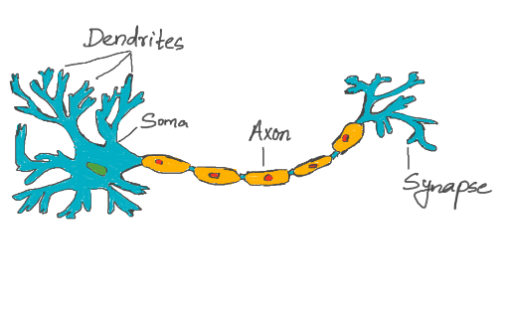
Biological neuron
Dendrite: Receives signals from other neurons.
Soma: Processes the information received.
Axon: Transmits the output of the processing.
Synapse: Point of connection.
Notes:
Basically a single neuron receives information through Dendrites, processes the information with the help of soma and transmits the output through Axons, which in turn can pass onto other neurons through connection links called synapses

Slide 7
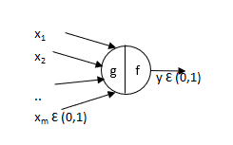
McCulloh PitTS Model –Artificial Neuron
McCulloch and Pitts created first artificial neural network by mimicking biological neuron functionality in 1943.
The inputs are fed to ‘g’. It performs an aggregation (sum of binary inputs), and 'f' takes a decision based on the aggregation.
If the sum exceeds a threshold value, the output is 1 else 0.
This model works on linearly separable data.
Notes:
The inputs and output are Boolean

Slide 8
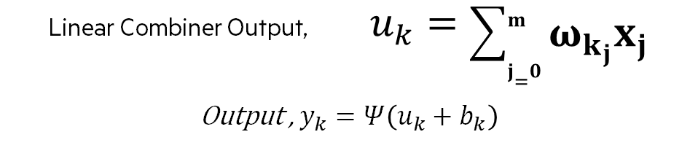
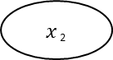
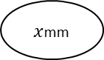
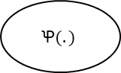
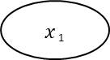
Perceptron model
In 1957, Frank Rosenblatt modified the above artificial neuron model known as perceptron.
Input
Weights
Net input
Function
Activation function
1
W₀
b_{k}
$x$ ₁
W₁
Output, y_{k}
∑
$$Ꝕ(. )$$
$x$ ₂
W₂
v_{k}
W_{m}
$x$mm
Linear Combiner Output, $u_{k}=\sum_{j=0}^{m}{ω_{k_{j}}x_{j}}$
Output , $y_{k}=Ψ\left(u_{k}+b_{k}\right)$
Notes:
$b_{k}$ : The bias
$v_{k}$ = $u_{k}+b_{k}$ : The activation potential.
Ꝕ(.): The activation function.
y_{k :} The output signal of the neuron.
The use of bias b_{k} has the effect of applying an affine transformation to the output u_{k} of the linear combiner in the model of the neuron.
Perceptron’s play an important role in binary classification. They are also referred to as binary classifiers.

Slide 9

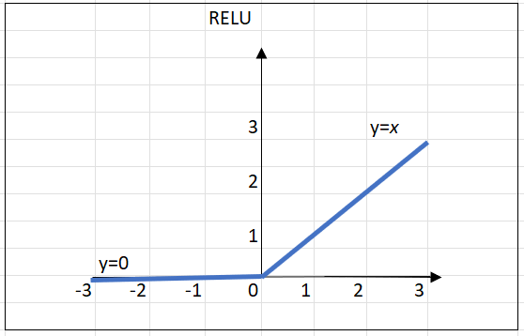
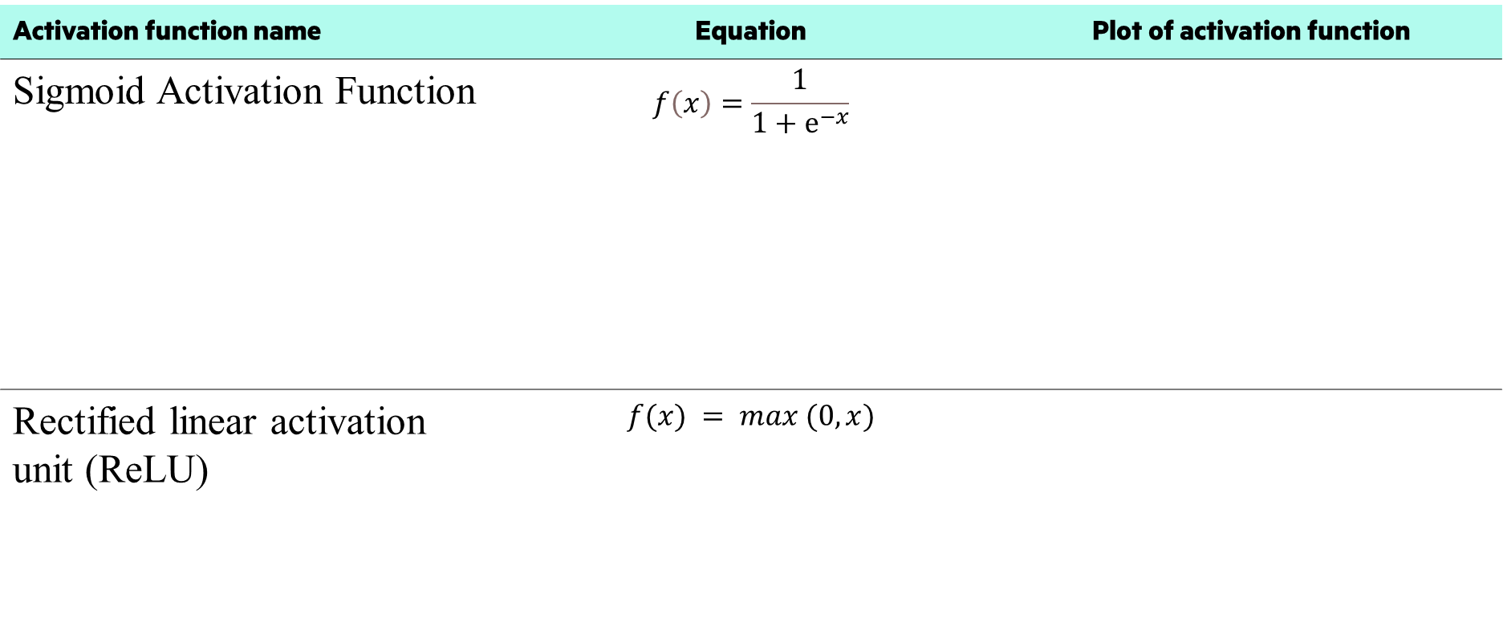
Activation function
Activation function name | Equation | Plot of activation function
Sigmoid Activation Function | $$f\left(x\right)=\frac{1}{1+ⅇ^{−x}}$$
Rectified linear activation unit (ReLU) | $$f(x) = max (0, x)$$

Slide 10
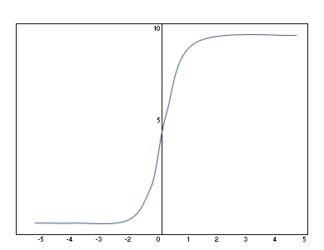
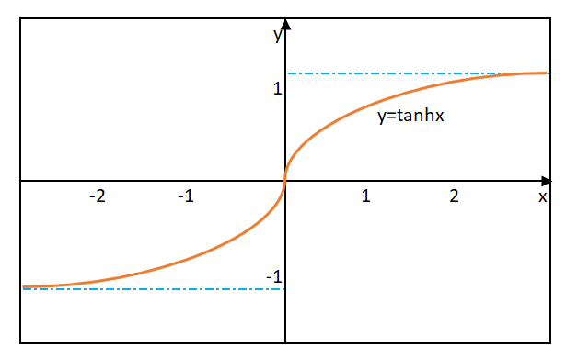
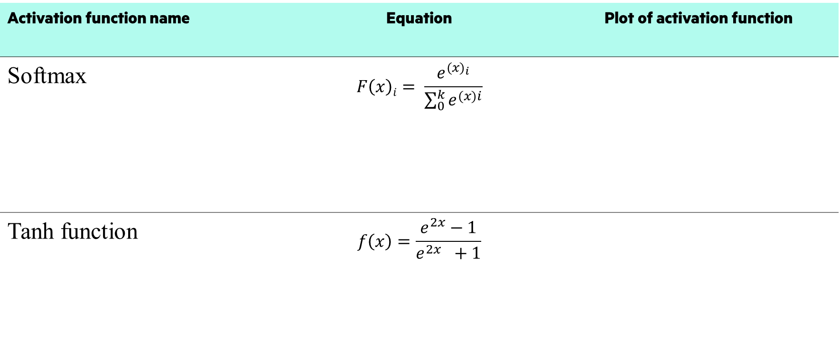
Activation functions
Activation function name | Equation | Plot of activation function
Softmax | $$F\left(x\right)i= \frac{e^{({x)}_{i}}}{\sum_{0}^{k}{e^{(x)i}}}$$
Tanh function | $$f\left(x\right)=\frac{e^{2x}−1}{e^{2x }+1}$$

Slide 11
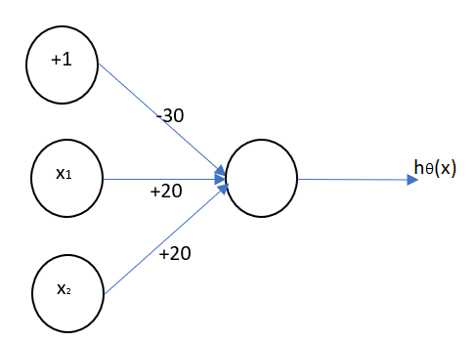
AND Logical function
Consider x1, x2 Ɛ {0,1} and have y = x1 AND x2, w1=30, w2=20 and w3=20. The neural network can be implemented as shown
x₁ | x₂ | h_{θ} (x)
0 | 0 | f (-30) ≈ 0
0 | 1 | f (-10) ≈ 0
1 | 0 | f (-10) ≈ 0
1 | 1 | f (10) ≈ 1
Computation, h_{θ} (x) =f (-30 + 20x₁ +20 x₂)
Notes:
Perceptron’s can classify if the data is linearly separable. If the classes are non-linearly separable, for example XOR function cannot be solved by perceptron.

Slide 12
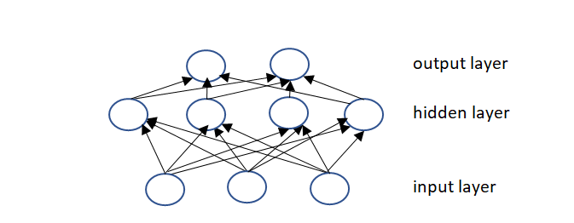
Multilayer neural networks
Multilayer network consists of input layer, hidden layer, and output layer.
Output from each layer is connected to the inputs of next layer.
Input layer receives the data that is considered for the algorithm

Slide 13
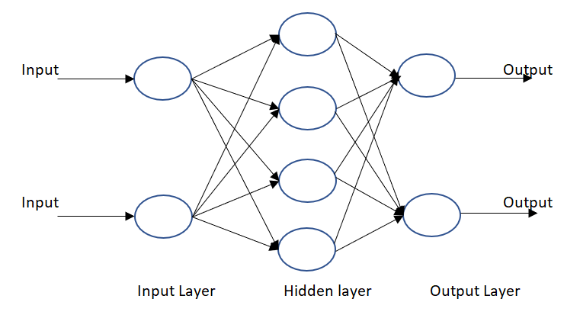
Feed Forward networks
In case of feedforward networks, there is no feedback path present.
Input * weight = guess
The ground truth about the data is taken and is compared with the guesses
Ground truth - guess = error
Depending upon the error, the network tries to adjust the weights to reduce the error.
Error * contribution of weights to error = adjustment.
Notes:
The distinction between ground truth and networks guess is known as error.
Advantages:
It can model complex and non-linear functions easily.
Easy to maintain deep networks as well.
Disadvantages:
Prone to overfitting.
As there are a greater number of parameters, it may take more time to converge and more inference time and model size.

Slide 14
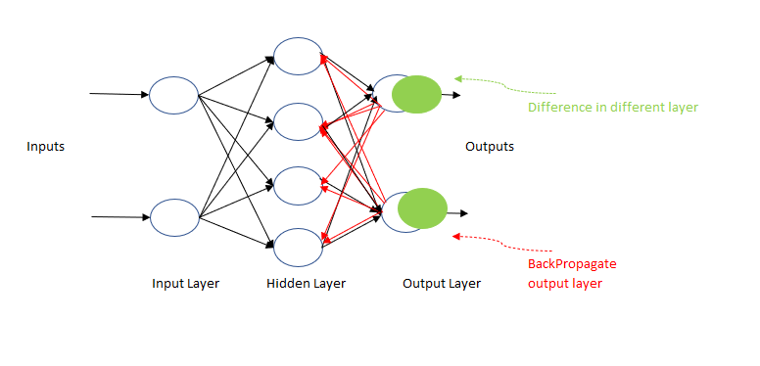
Backpropagation algorithm
Backpropagation means “backward propagation of errors”.
The steps for backpropagation algorithm
1)Inputs enter through the input layer.
2)Weights are selected randomly and inputs are modeled using the weights.
3)Output is calculated for each neuron passing through the hidden layer.
4)Error is calculated which is the difference between actual output and desired output.
5)Again propagate in the backward direction to adjust the weights to reduce error.
The processes are repeated until desired output is obtained.
Notes:
Advantages of backpropagation:
Simple, fast and easy to program
It does not require networks prior knowledge.
Other than inputs, no other parameters need to be tunes.
Features of the function need not be specified to be learned.
Disadvantages of backpropagation:
The performance is dependent on the input data.
In some applications, algorithm is sensitive to noisy data.

Slide 15
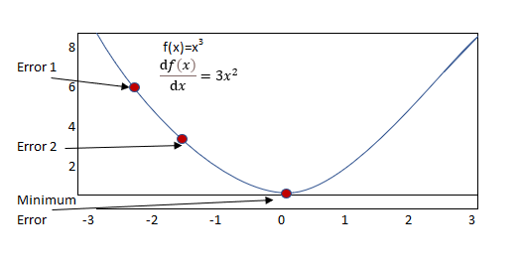
Gradient descent
To optimize the cost function or the error of the model, gradient descent is used.
Gradient descent (GD) is an iterative first-order optimization algorithm used to find a local minimum/maximum of a given function
The error in the model must be reduced quickly without much resource wastage

Slide 16
Types of gradient descent
Batch Gradient Descent:
The error is calculated for each sample within the training dataset.
The model gets updated only after the entire training samples have been evaluated.
Stochastic Gradient Descent:
The error is calculated for each training sample and parameters are updated then and there itself.
The model gets updated each time the error is evaluated.
Mini Batch Gradient Descent:
Combination of the first two methods.
Training samples are divided into small batches and the model gets updated after each batch is updated on the error.

Slide 17
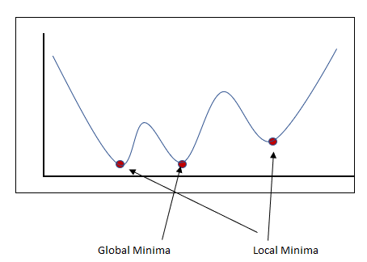
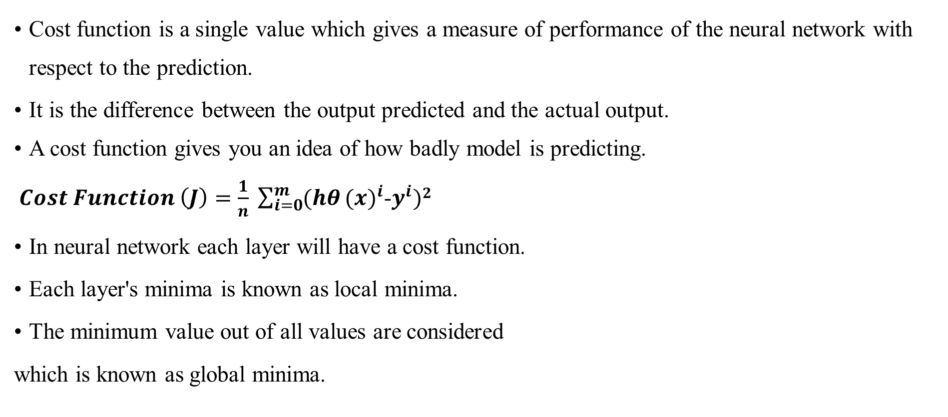
Cost function
Cost function is a single value which gives a measure of performance of the neural network with respect to the prediction.
It is the difference between the output predicted and the actual output.
A cost function gives you an idea of how badly model is predicting.
$Cost Function \left(J\right)=\frac{1}{n} \sum_{i=0}^{m}{(hθ}{(x)}^{i}$-$y^{i})2$
In neural network each layer will have a cost function.
Each layer's minima is known as local minima.
The minimum value out of all values are considered
which is known as global minima.

Slide 18
Lesson-2 Deep Neural Networks

Slide 19
Introduction to dnn
Deep neural networks (DNNs) are networks which has more than one hidden layer.
Simple features in input data recombine from one layer to the next forming complex features.
Hidden layers help to learn the features of the data in a form of feature hierarchy.
Neural networks with one or two hidden layers are known as shallow networks and more than three are known as deep neural networks.

Slide 20
Training a neural network
Multiple iterations known as epochs are carried out to train a deep neural network.
Random initialization values are assigned to weights(w) and bias(b) values are assigned for the first epoch.
Later the process is as follows.
Features of data observations with known labels are generally grouped into batches. (also referred as mini-batches).
The neurons with activation functions applied are sent to the next layer until output are generated.
The error is calculated.
The revised weights are calculated, and adjustments are done to the neuron weights.
The next epoch repeats the forward pass with revised weights and bias values to improvise the model accuracy.

Slide 21
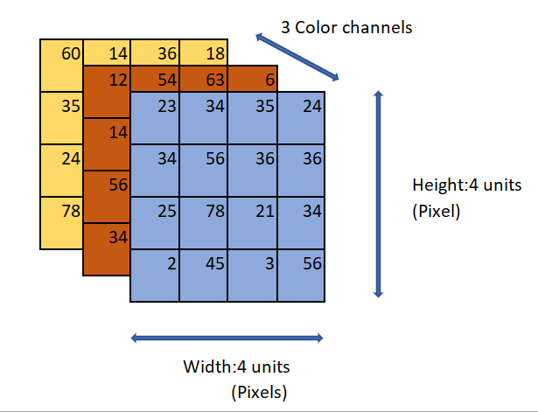
Convolutional neural networks
Convolutional Neural Networks (CNNs) are Deep Learning methodologies that take an input image and give importance (weights and biases) to distinct entities in the image, allowing them to be distinguished.
Like the neuron connection pattern in the human brain.
Capture the Spatial and Temporal correlations in a picture by applying filters.
Consider an example of a three-color input image (red, green, and blue) (RGB).
Notes:
Images are ingested and processed as tensors by CNN’s. Matrices of numbers with additional dimensions are tensors. A scalar for example ‘6’ is one dimensional whereas a vector is two-dimensional. A three-dimensional cube is a stack of matrices. The three dimensions are width, height, and depth. Arrays nested within arrays and infinitely nested arrays accounts for dimensions greater than what we can visualize. Order is tensor’s dimensionality; therefore, fourth order tensor would have four dimensions. Red-Green-Blue (RGB) encoding produces three-layer deep image. Each layer is called a channel. Grayscale, RGB, HSV, CMYK, and more image formats are available in CNN.

Slide 22
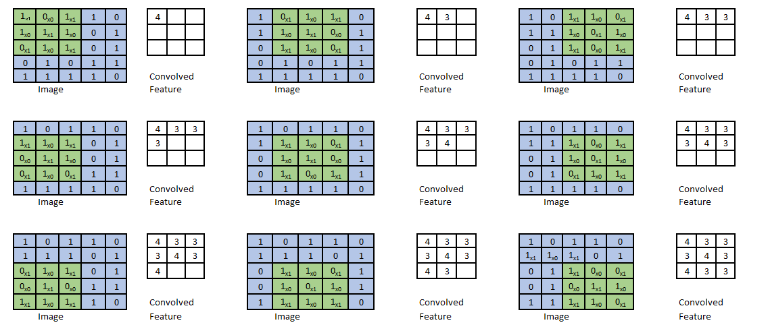
Convolution Neural Networks
Convolutional Layer - kernel
Convolution is measuring how two functions overlap in an integral way as they pass over.
One matrix is a kernel, and the other is the data portion overlapping with the kernel.
A kernel helps to extract features from the image.

Slide 23
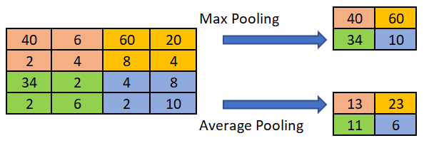
Convolutional neural networks
Pooling/sub-sampling
Limits the number of parameters and calculations in the network by steadily shrinking the spatial dimension of the representation.
There are three types of pooling: maximum pooling ,average pooling and minimum pooling
Max Pooling extracts the maximum value from the portion of the image covered by the Kernel.
Average Pooling returns the average of all the values from the image's Kernel section.
Minimum pooling gives minimum value.

Slide 24
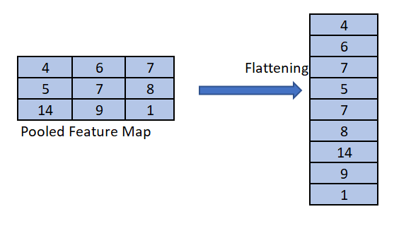
Convolutional neural networks
Flattening
Fully Connected Layer
Flattening is done to convert the matrix to a 1-D array.
The fully connected layer is the layer that connects all the neurons with all other neurons in the next layer
The fully connected layer (FC) has weights and biases used to connect the neurons between two layers.

Slide 25
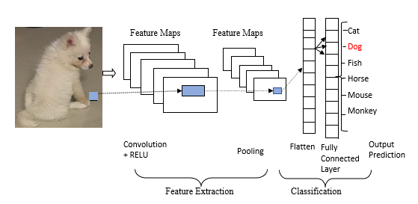
Convolutional neural networks –An example

Slide 26
Applications of convolution neural networks
Speech recognition
Image classification
Facial Recognition
Climate predictions
Natural Language Processing

Slide 27
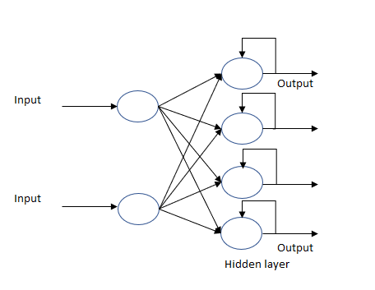
Recursive neural networks
In RNN, there is a path from the output towards the input layer of the system.
The input gets influenced partly by the feedback signal.
The category of artificial neural network which uses feedback path are known as Feedback Neural Net.
As recurrent neural networks have memory, they can remember previous inputs.

Slide 28
Types of rnn
Notes:
One to one: If input is fed to a hidden layer and produces a single output like image classification scores that implies one to one network.
One to Many: But machine learning should provide the flexibility to handle various kinds of data, for example Image captioning where for an input image, captions should be generated. In this case one to many can be used.
Many to one: Input could be a sequence of text and generate sentiments i.e sentiment classification.
Many to many: Input and output could be variable in length like Machine translation. In machine translation the input could a sentence in English of variable length and must translate it to an output of variable length in another language. Also, the length of input and output can be variable as well. Also, to process video sequences RNN’s can be used.

Slide 29
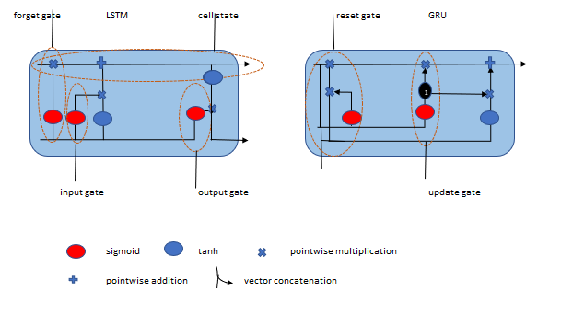
Lstm (long short-term memory)
RNN can remember things for a short duration of time.
In LSTM, a memory structure is introduced, which is controlled by a gate that decides the things to remember, things to forget and the things to output.
LSTM is very productive for time series forecasting based problems.
LSTM handles selective filtering of data based on gates.
LSTM has three gates
i) Forget gate ii) Input gate and iii) Output gate.
Forget gate decides what information we are going to throw away from the cell.
Input gate decides which information is allowed to pass inside the cell layer
Output gate decides what we are going to output.

Slide 30
gated recurrent network(gru)
The forget and input gates are replaced with an update gate, which combines both the types.
GRU has only two gates known as reset gate and update gate.
GRU’s are computationally faster than normal LSTM with three gates.

Slide 31
Transfer learning
In transfer learning, the knowledge acquired by the machine learning model training can be utilized for a different but related problem.
A simple classifier model trained to detect sunglasses can be used for detecting face masks.
Training a machine learning model means we're updating the weights and biases according to the data set.
VGG16
VGG16 is a 16-layer multilayer network of 13 convolutional layers, each with a 3x3 filter size and fully linked layers. It was developed by Visual Graphics group

Slide 32
Resnet 50
ResNet is an abbreviation for residual networks.
It uses residual learning instead of learning from features.
Residual is the subtraction of feature learned from input of that layer.
The future layer is formed by combining the preceding layers.
Skipping one or more layers as shown in figure results in shortcut connections.
Skip connections do identity mapping, and their outputs are added to stacked layers.
ResNets optimizes easily compared to other networks where training error increases as depth increases.

Slide 33

DEMO
Github link

Slide 34
Lesson-3 Real time Deployment

Slide 35
Model serving - real-time deployment
Data Wrangling
Since the data scientist may have done many transformations to the data for training like one-hot encoding.
The same transformation needs to be provided to the real-time data from various sources
Storage
Need to reduce the storage size of the model without much impact on the performance.
API
According to the service structure of the ML model, the API structure needs to be carefully chosen.
Scheduling
Scheduling can be done periodically, or it can be triggered when the performance goes beyond a threshold

Slide 36
Model serving : real-time deployment
Logging and Monitoring
Proper logging of data and monitoring of health and conditions of deployment is crucial for making the model deployment fault-tolerant.
Security
ML models are usually dealing with critical data, and ML models take many crucial decisions.
Hence the security breach of the deployment can cause serious harm.
Visualizations and User Interfaces
The visualizations and UIs to be designed according to the target users

Slide 37
Use cases:- medical image analysis
A convolutional neural network can identify edges, shapes, and even more sophisticated features over an image.
Steps involved in medical image analysis
Selection of data set, medical image data set is available from various sources.
Preparation of data, Image augmentation process, can be used to expand the size of the data set.
Selection of CNN model, the filter sizes, pooling layer, and stride lengths.
Model iteration
5. Evaluation of the model.
CNNs for Skin Cancer Diagnosis
Skin cancer or Melanoma is a deadly disease.
The diagnosis of skin cancer is carried out on the dermatoscopic images taken with a high-resolution magnifying camera.
CNN can be utilized for skin cancer diagnosis.

Slide 38
Use cases:- medical image analysis
Visual Data Processing for Tumor Detection
The tumor images can be classified based on the visual features of the cancer images.
The images and its masks can be visualized, and classification model can be trained using transfer learning modules such as ResNet-50
This network has the capability to classify images into various categories, which can be utilized in identifying if the image has tumor or not.
In addition, computer vision algorithms can also be used for the detection of tumor cells.

Slide 39
DEMO
Github link

Slide 40
Thank you

